Slide 1
Accelerating Deep Learning Research with the NSF NRP Nautilus HyperCluster
MORENet Technical Summit
20 Feb 2023

Slide 2
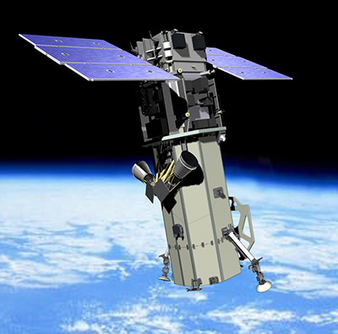
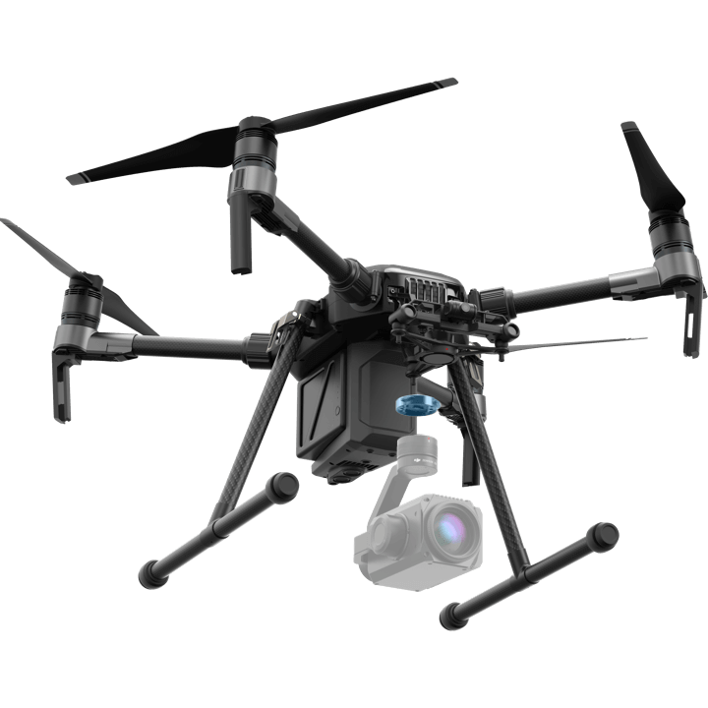
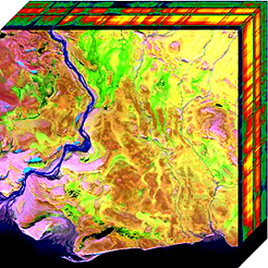
Problem Space: Deep Learning in Remote Sensing
Remote Sensing imagery sources:
Satellites
Unmanned Aerial Systems (UAS)
Remote sensing is a Big Data problem!
Satellites collect imagery 24/7/365
Trillions of pixels per day
High levels of dimensionality available
Multispectral and hyperspectral imagery
Notes:
Scene/Chip classification
Bounding box localization
Semantic segmentation
Instance segmentation
Change detection
Health monitorization

Slide 3
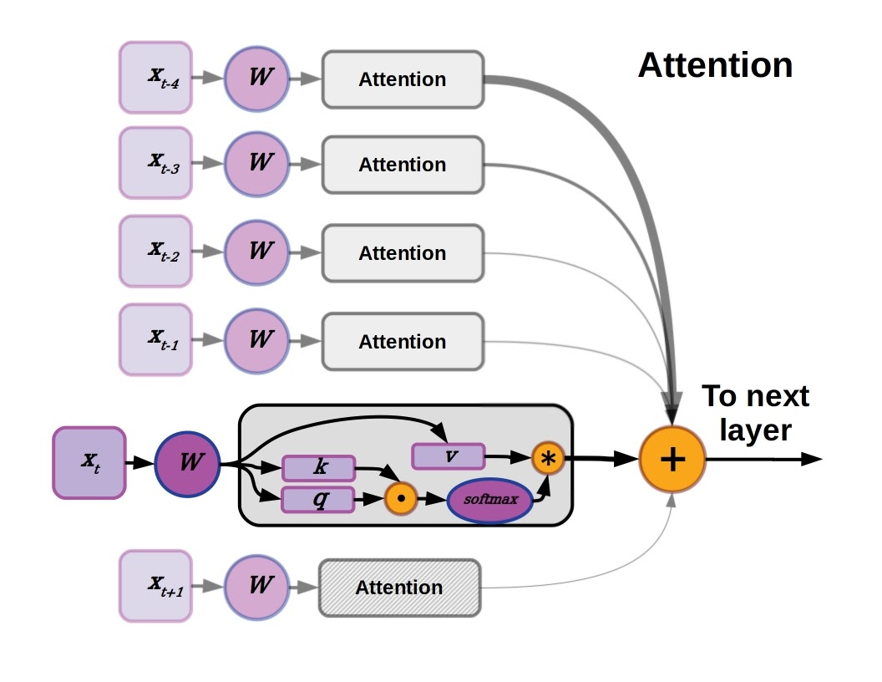
Problem Space: Deep Learning & Remote Sensing
Countless number of models available in modern CV
Model training time and resource requirements are oftentimes the bottleneck
Models built for ground-photo CV do not always translate effectively to RSI applications
We want to train & evaluate state-of-the-art Deep Neural Networks (DNNs) on RSI datasets
Several CV tasks in RSI Applications
Classification
Segmentation
Object Detection

Slide 4
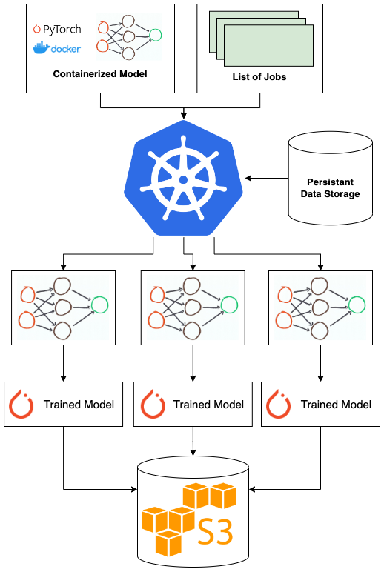
System Overview: Nautilus for Accelerated Deep Learning Research

Slide 5



Containerization of Deep Neural Architectures
Deep Learning Libraries contain implementations of popular DNN Object Detection architectures
Faster R-CNN, YOLO, SWIN, etc.
Availability of pretrained weights from large, CV datasets, which enables fine tuning on RSI datasets
MS COCO and ImageNet-1K
Utilization of NVIDIA NGC as base container image
Optimized PyTorch containers for Deep Learning
Containerized two PyTorch-based Object Detection Deep Learning Libraries:
MMDetection (Open MMLab)
Detectron2 (Facebook AI Research)

Slide 6
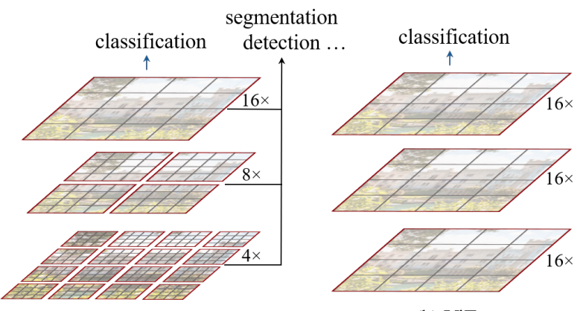
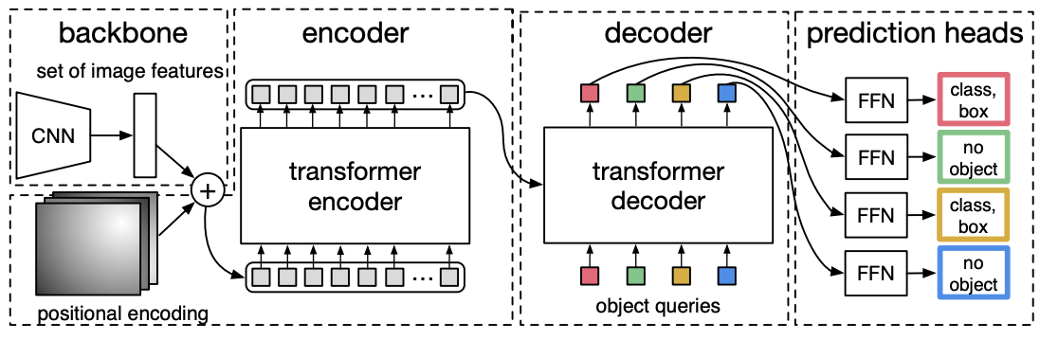
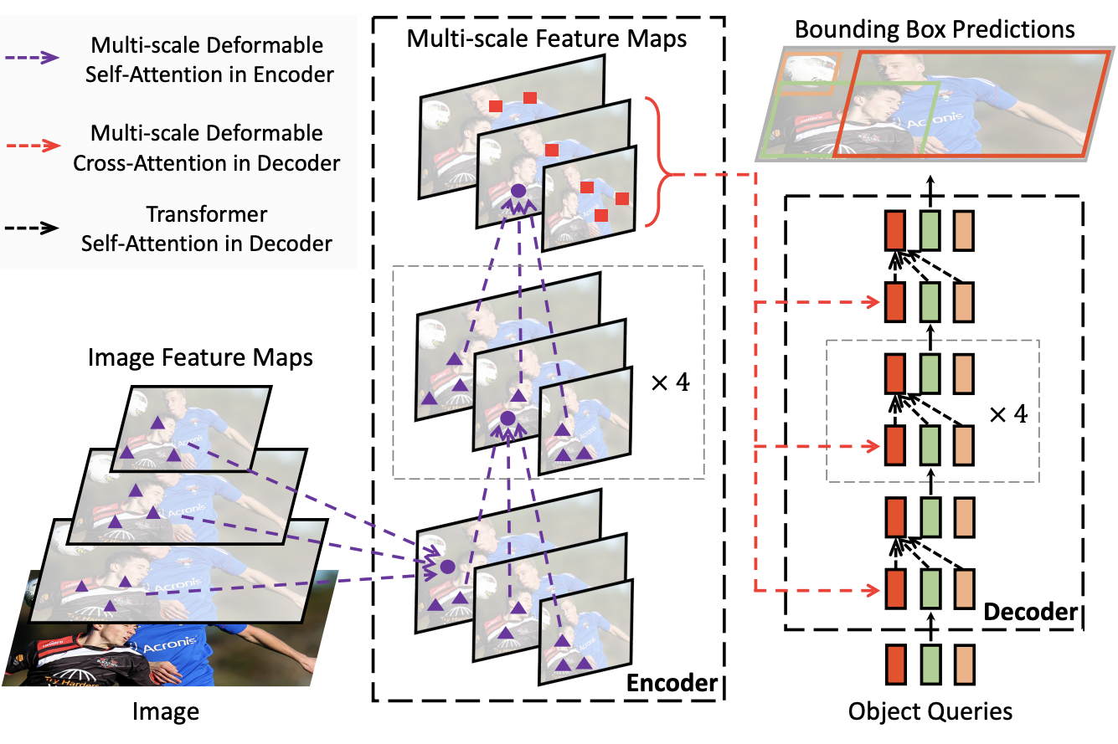
Models Containerized: Transformers
SWIN Transformer (2021)
DETR (2020)
Deformable DETR (2020)
ViT (2020)
Images taken from original architecture publications

Slide 7
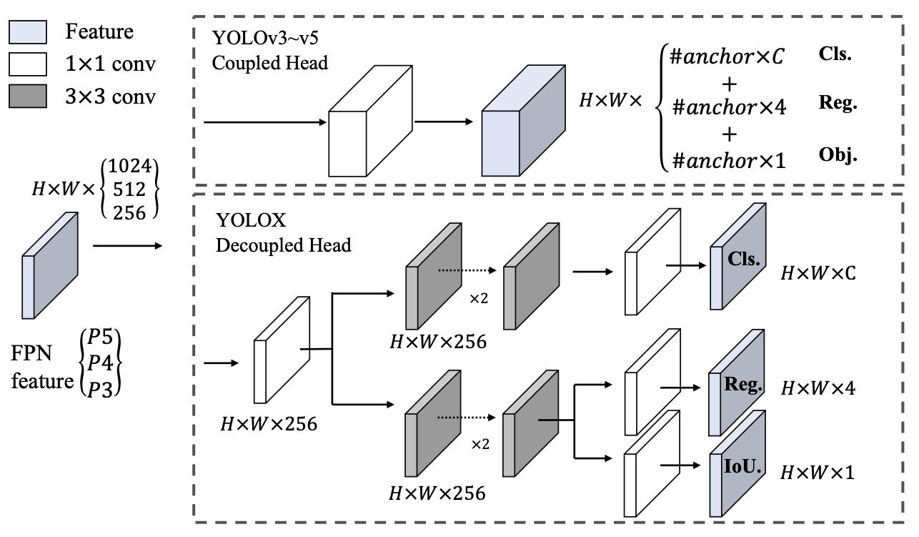
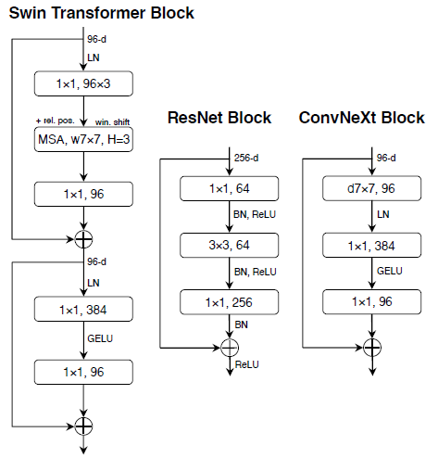
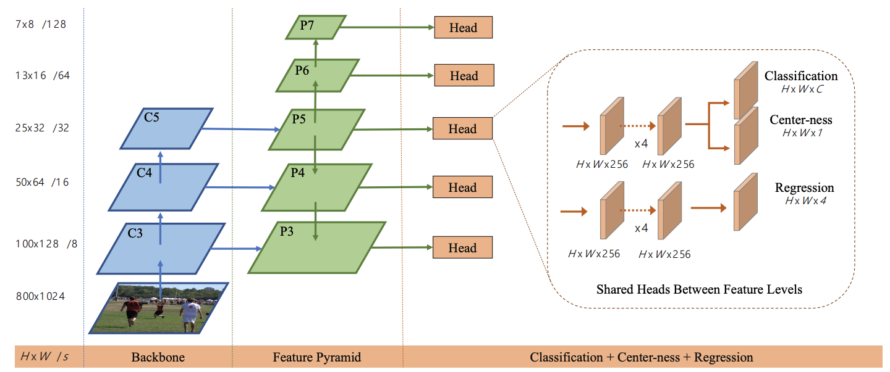
Models Containerized: Convolutional Networks
ConvNext (2022)
YOLOX (2021)
FCOS (2020)
YOLOv3 (2018)
RetinaNet (2017)
SSD (2016)
Images taken from original architecture publications

Slide 8
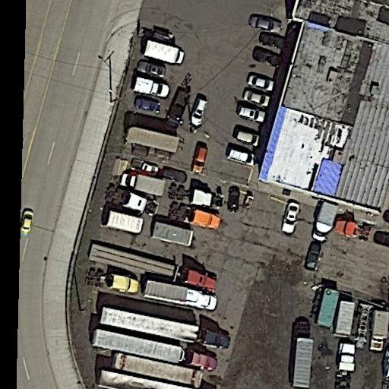
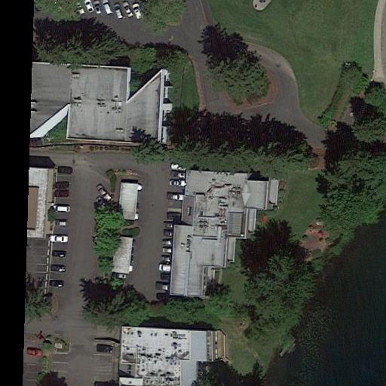
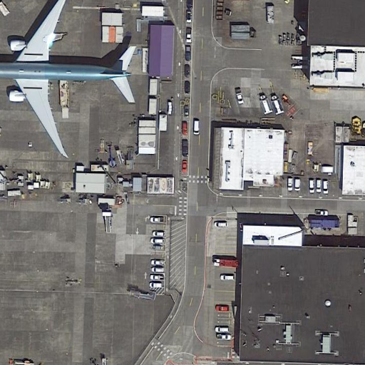
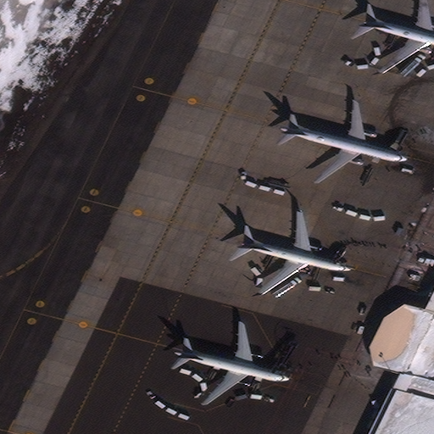
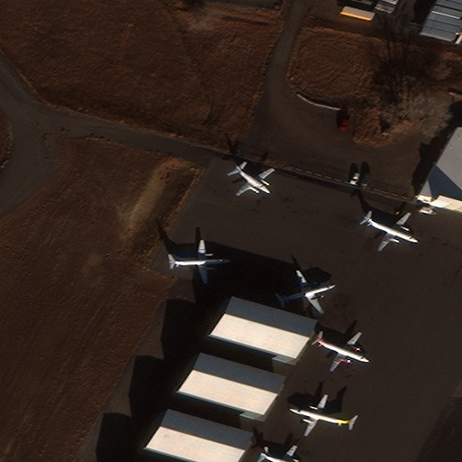
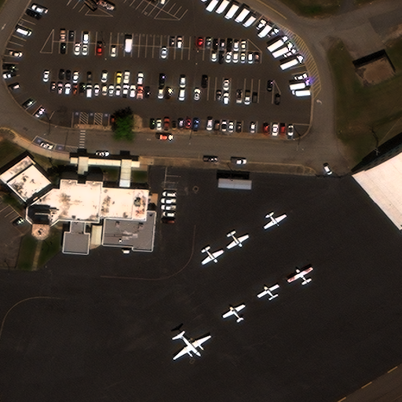
Detection Datasets
DOTA (version 1.5)
Overhead Remote sensing dataset
1869 scenes with 280,196 objects in 16 classes
Imagery chipped to enable better GPU acceleration
RarePlanes (real data)
Pre-tiled, Pan-sharpened RGB dataset
Aircraft detection dataset
17,050 tiles containing 25,205 aircraft belonging to 7 classes
3 commercial aircraft classes
4 military aircraft classes
DOTA
RarePlanes
Xia, Gui-Song, et al. "DOTA: A large-scale dataset for object detection in aerial images." Proceedings of the IEEE conference on computer vision and pattern recognition. 2018.
Shermeyer, Jacob, et al. "Rareplanes: Synthetic data takes flight." Proceedings of the IEEE/CVF Winter Conference on Applications of Computer Vision. 2021.

Slide 9
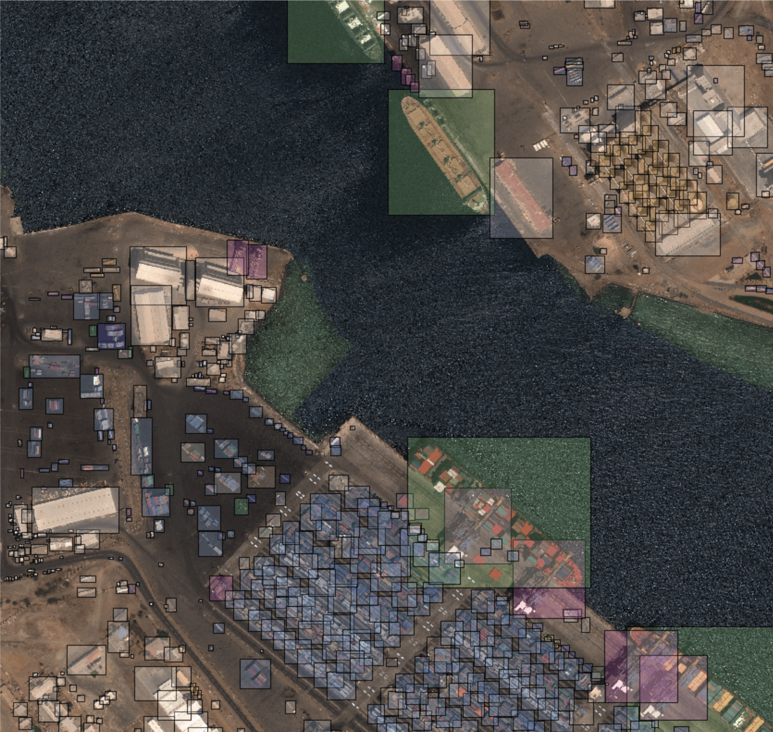
Detection Datasets (cont.)
XView
Released by DIUx in 2018
Over 1 million objects
61 classes (60 + BG)
Heavily unbalanced
Most sparse class: 17 labels
Most dense class: 316,765 labels
Lam, Darius, et al. ”XView: Objects in context in overhead imagery." arXiv preprint arXiv:1802.07856 (2018).

Slide 10
Automating Kubernetes Jobs
Creation of template Kube Spec YAML
Bash scripting combined with environment variables to set the Dataset and Model to train
Human time: ~3 hours
spec:
template:
spec:
containers:
- name: myContainer
image: $CONTAINAER_IMAGE
workingDir: $WORKDIR
Template YAML
Dirs="mydir1 mydir2 mydir3 mydir4"
Container=“ubuntu:20.04”
for Dirpath in $Dirs; do
CONTAINER_IMAGE=$Container WORKDIR=$Dirpath envsubst < template.yml | kubectl apply -f -
done
Bash Script

Slide 11

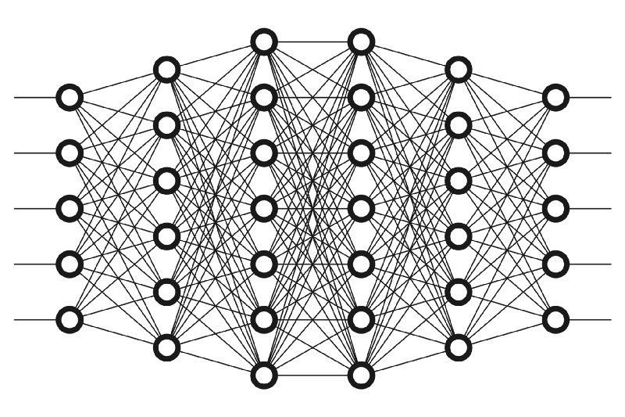


Deep Learning on Nautilus: By the Numbers
27 Trained Models
124.74 TB Imagery Processed
9 Deep Neural Architectures
Load Imagery
Forward Pass
Calculate Loss
Backward Pass
8,100 Epochs
30M iterations
1.7B parameters
3 Open Source
HR-RSI Datasets
Wall Clock Time:
76 days, 10 hours
https://www.freecodecamp.org/news/want-to-know-how-deep-learning-works-heres-a-quick-guide-for-everyone-1aedeca88076/
https://commons.wikimedia.org/wiki/File:PyTorch_logo_icon.svg
https://www.clipartmax.com/download/m2K9A0m2b1m2i8i8_4-o-clock-clip-art-clock-face-clip-art/

Slide 12





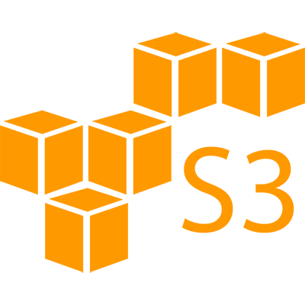
Future Work: Kubernetes and S3 Python APIs
Both AWS and Kubernetes publish Python packages with APIs to perform tasks in Python
Move from ad-hoc bash scripting to Python application that can better manage the creation of training jobs
Combine K8s and AWS Python API to automate copying of trained models and performance results to S3 bucket
job1:
workingDir: myDir1
spec: mySpecFile1.yml
job2:
workingDir: myDir2
spec: mySpecFile2.yml
YAML Config File
Nautilus
Job
Job
Persistent Storage
Python App
Local Directory

